Slide 1
Stock Screener using RL
Aditya Wadnerkar
Github Link: https://github.com/aadityaw97/Stock-Screener-using-RL

Slide 2
MELT UP
Last phase of bull market
Maximum returns higher than ever during the time period

Slide 3
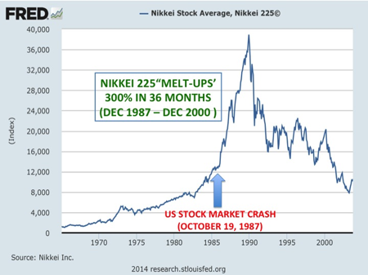
NEKKEI MELT UP

Slide 4
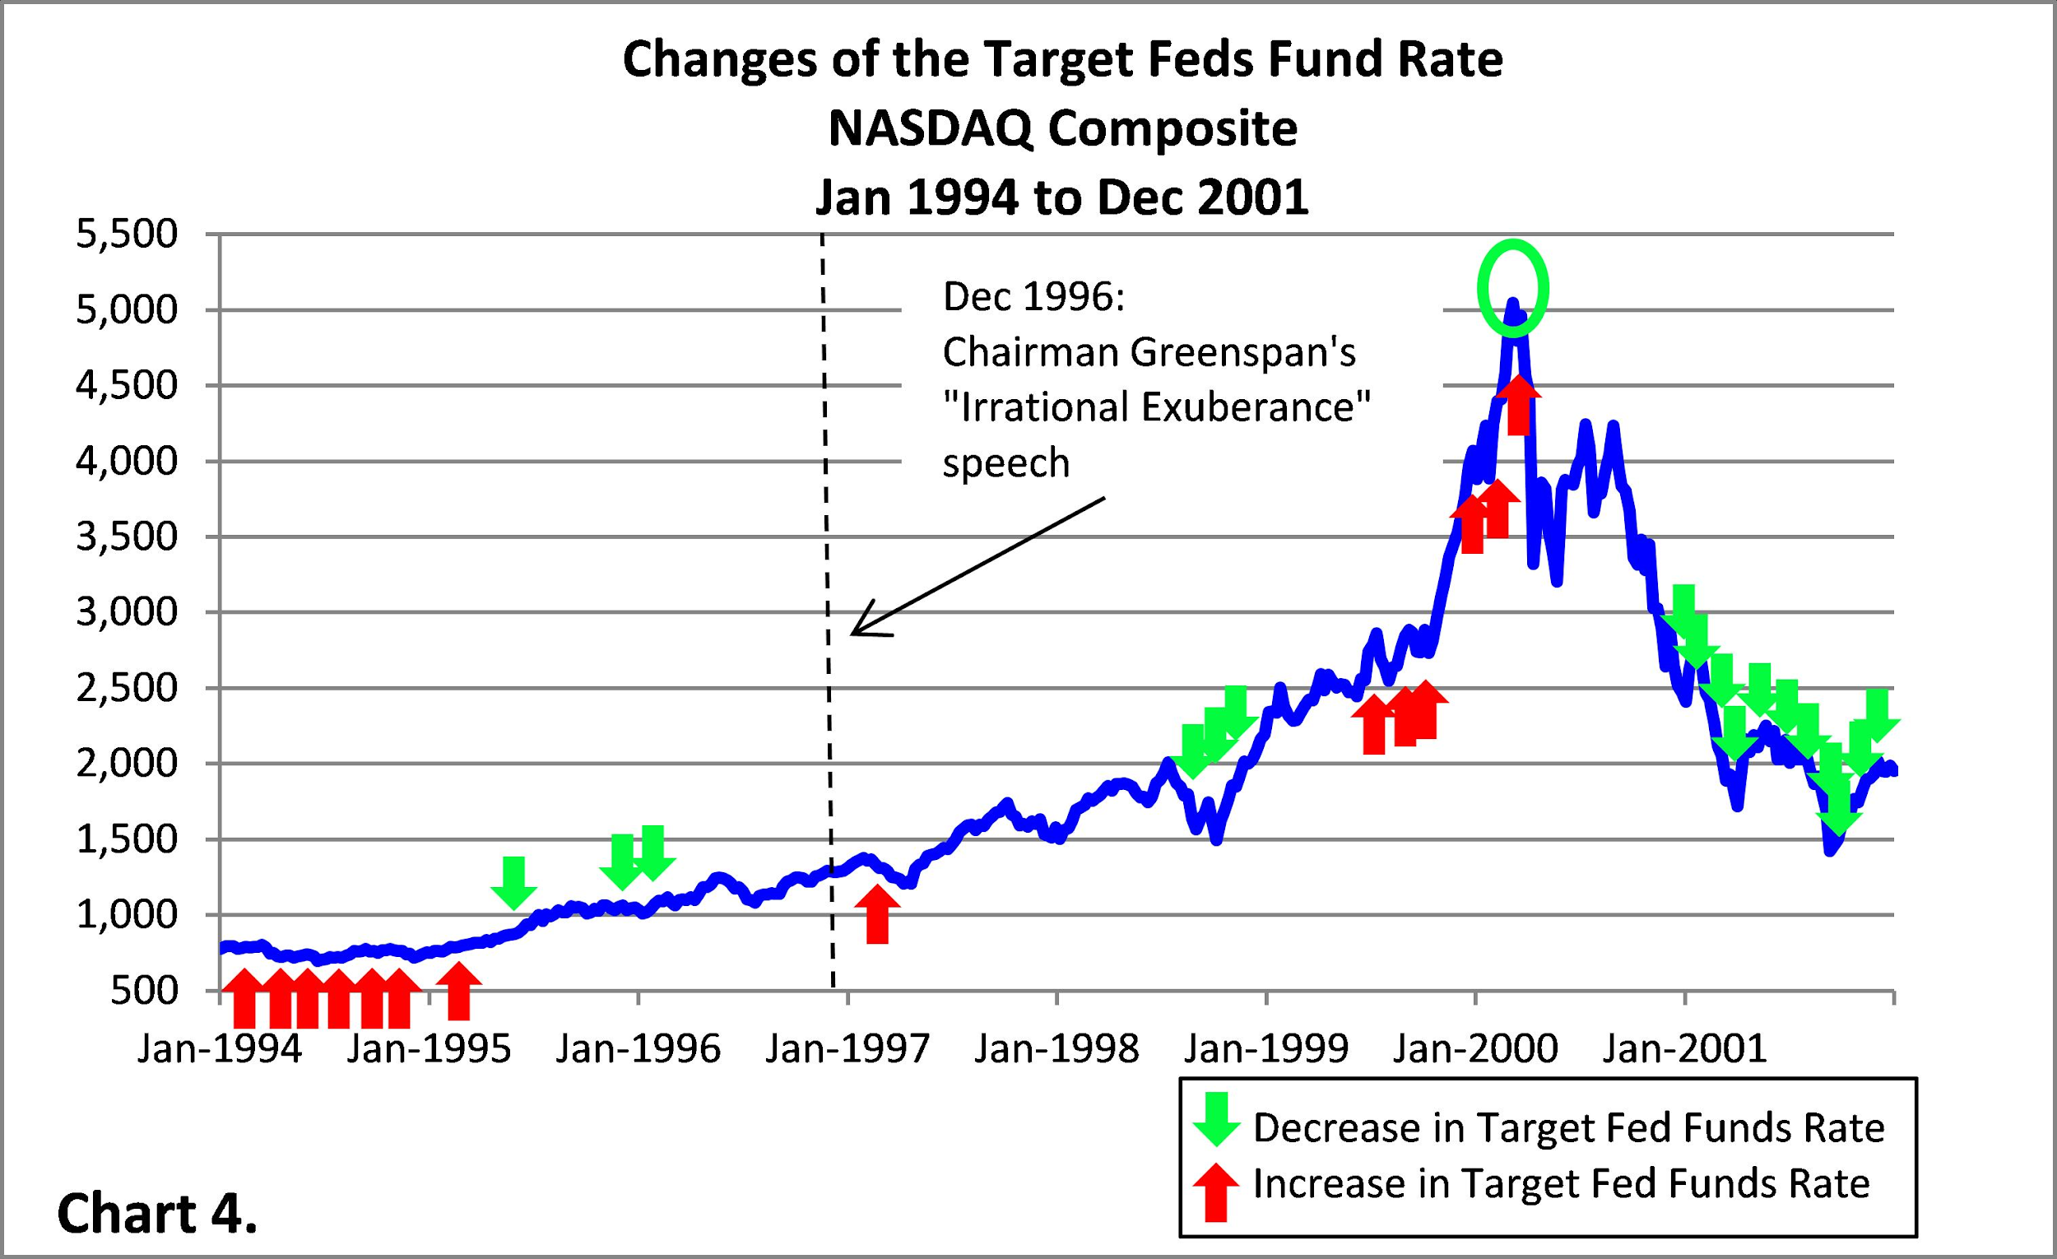
The “Dot Com” Bubble

Slide 5
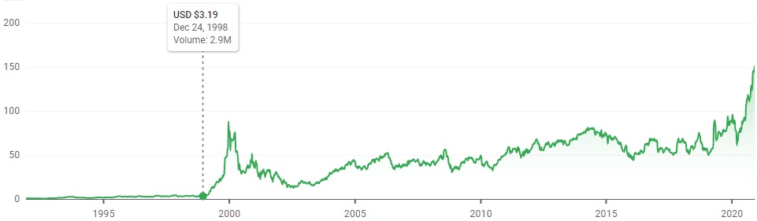
Qualcomm
Identify potential “Break-out” candidates
Qualcomm gave +2700% returns during the “tech bubble”

Slide 6
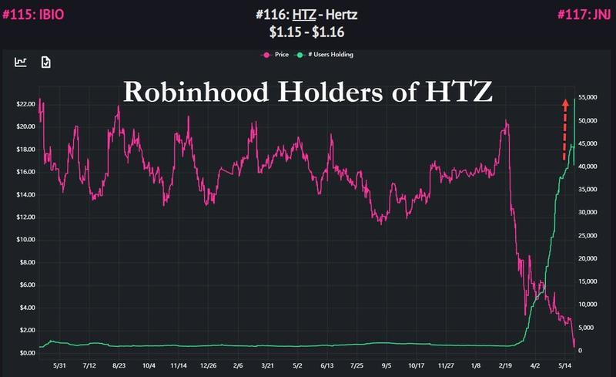
HTZ
Avoid falling for “Bull Traps!”
Hertz car rental filed for bankruptcy

Slide 7
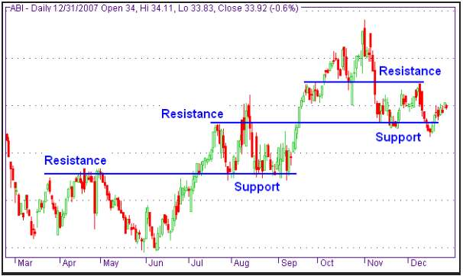
Resistance and Support Levels

Slide 8
CODE REVIEW
Github Link: https://github.com/aadityaw97/Stock-Screener-using-RL

Slide 9
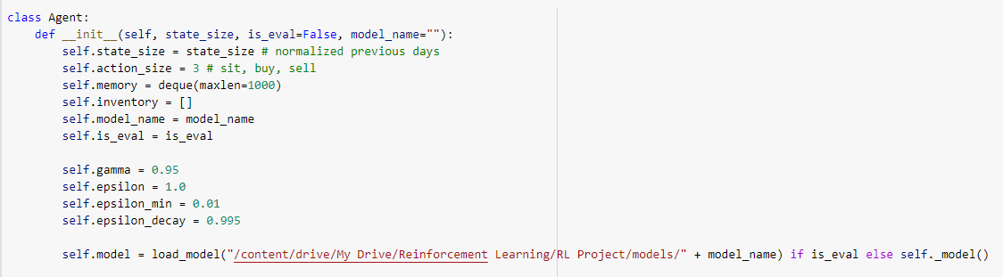
Agent

Slide 10
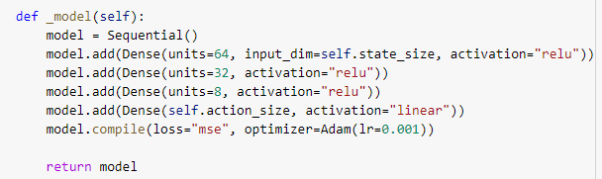
Model

Slide 11
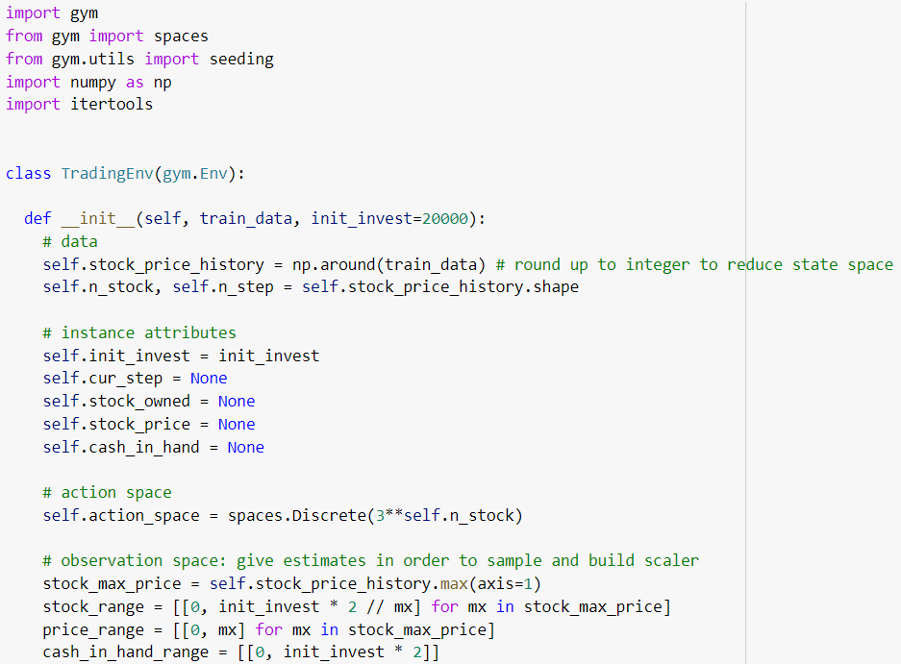
Environment

Slide 12
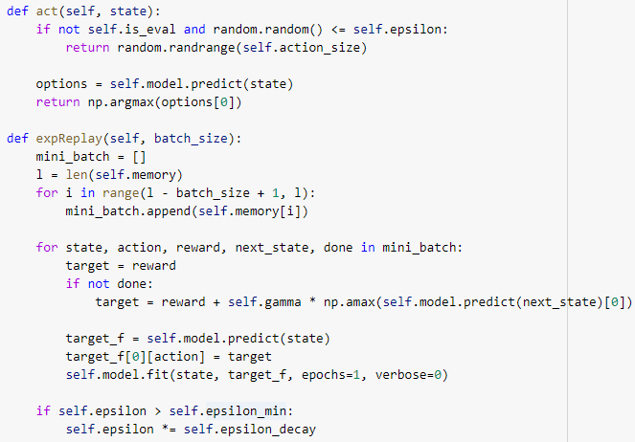
State

Slide 13
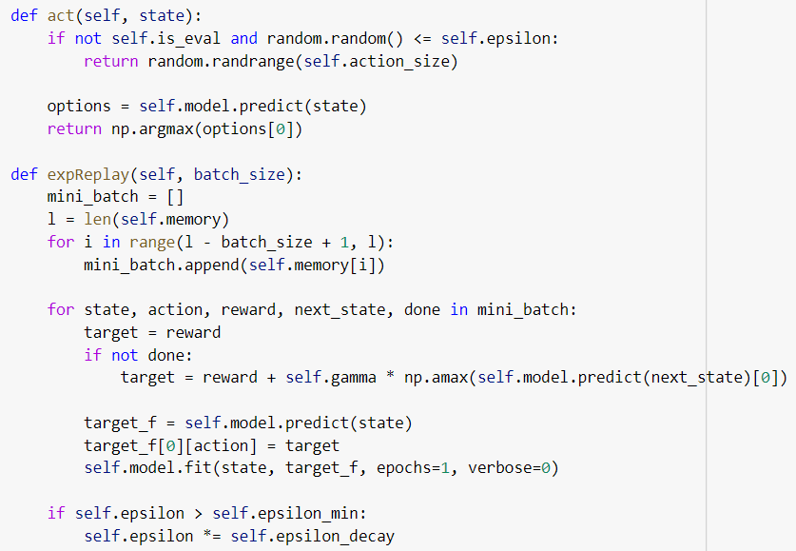
Action

Slide 14
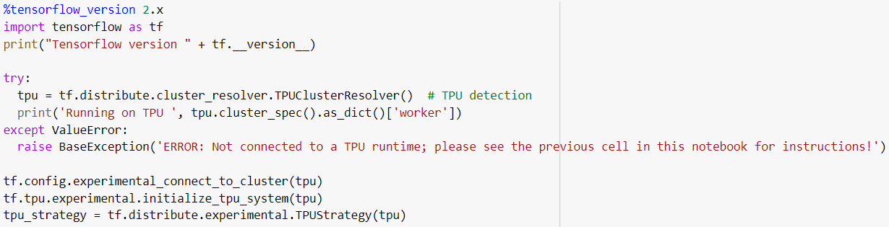
TPU Initialization

Slide 15
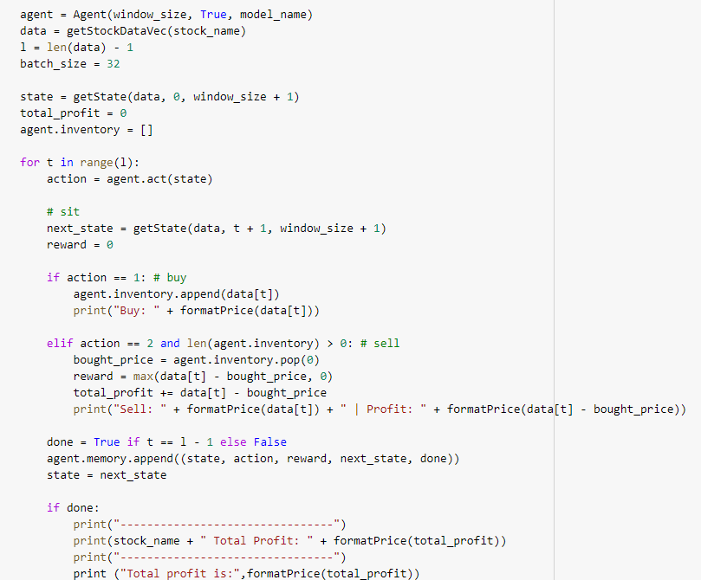
Train Model

Slide 16
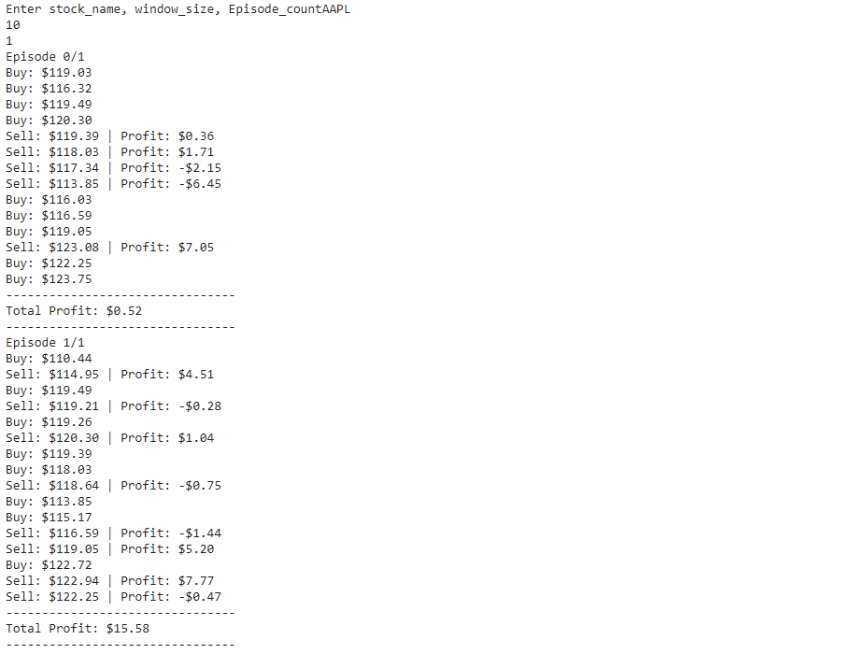
Trades per epoch

Slide 17
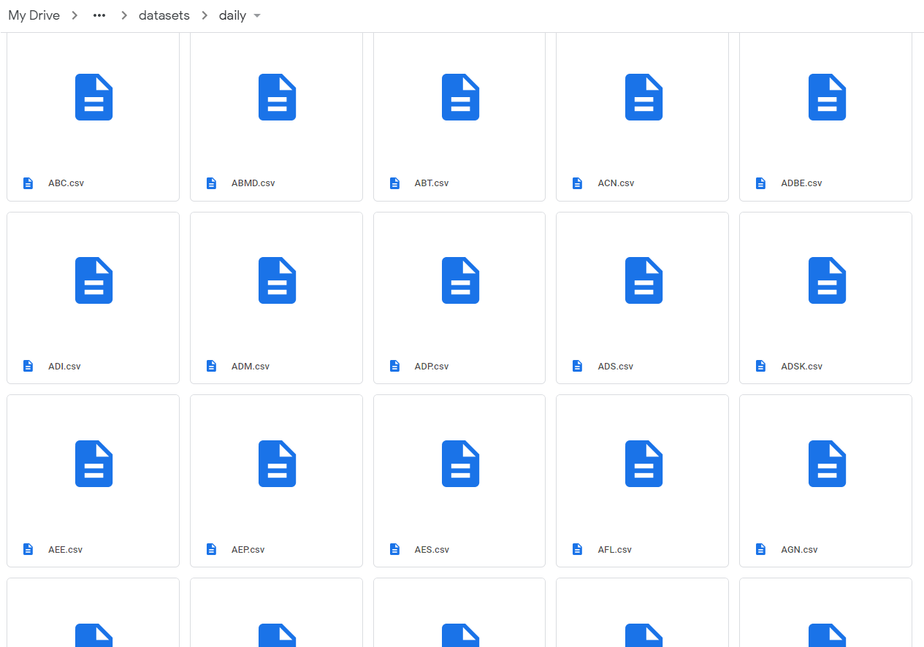
Nasdaq
Stocks

Slide 18
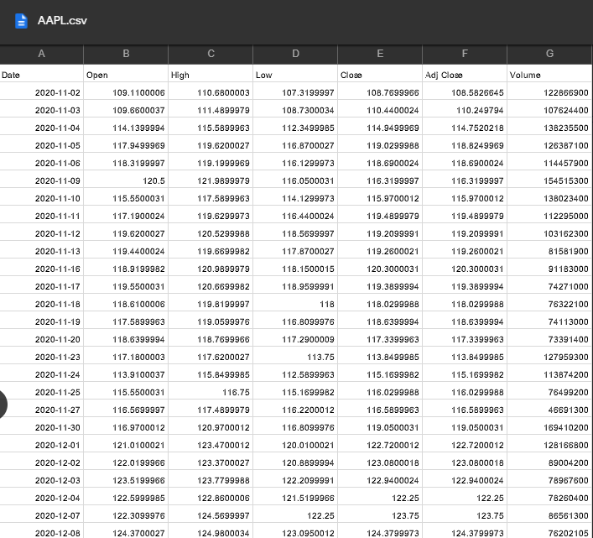
Dataset

Slide 19
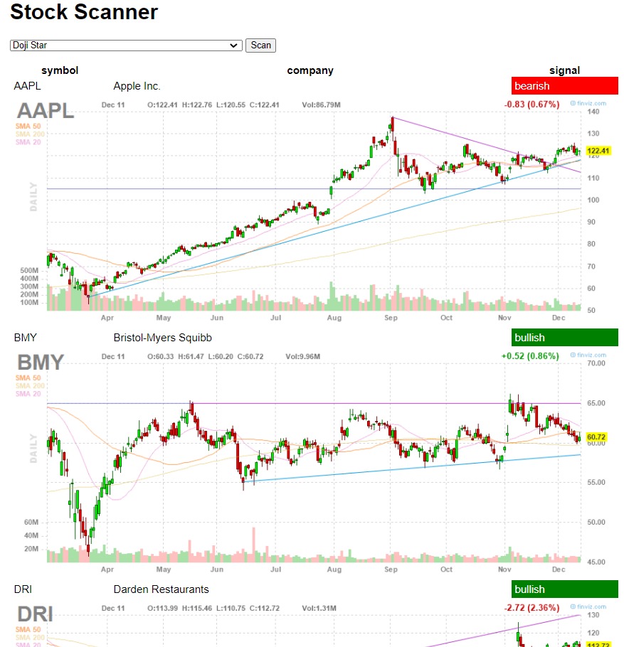
Screen Stocks

Slide 20
References
1) [AI4Finance-LLC, Deep Reinforcement Learning for Automated Stock Trading Ensemble Strategy ICAIF 2020](https://github.com/AI4Finance-LLC/Deep-Reinforcement-Learning-for-Automated-Stock-Trading-Ensemble-Strategy-ICAIF-2020)
2) [llSourcell, Q Learning for Trading](https://github.com/llSourcell/Q-Learning-for-Trading)
3) [Hacking the Markets, Candlestick Screener](https://github.com/hackingthemarkets/candlestick-screener)
4) [Part Time Larry, 9 Aug 2020, Finding Breakout Candidates with Python and Pandas](https://www.youtube.com/watch?v=exGuyBnhN_8)

Slide 21
DEMO

Slide 22
THANK YOU

